Slide 1
3-2 USING FREQUENCY ADVERBS: ALWAYS, USUALLY, OFTEN, SOMETIMES, SELDOM, RARELY, NEVER
100%
(a) Mary always eats lunch at school.
90%- 99%
(b) Mary usually eats lunch at school.
75%- 90%
(c) Josh often eats hamburgers.
25%- 75%
(d) Tia sometimes eats lunch at school.
1%- 10%
(f) Eva hardly ever washes her car.
0%
(g) Jay never goes to the zoo.
frequency adverbs

Slide 2
3-2 Let’s Practice
always
usually
often
sometimes
seldom
rarely
never
Talia _______ feeds her dog.
always
Sun.
Mon.
Tues.
Wed.
Thurs.
Fri.
Sat.
√
√
√
√
√
√
√

Slide 3
3-2 Let’s Practice
always
usually
often
sometimes
Hardly ever
rarely
never
Jara __________ watches TV.
hardly ever
Sun.
Mon.
Tues.
Wed.
Thurs.
Fri.
Sat.
√

Slide 4
3-2 Let’s Practice
always
usually
often
sometimes
seldom
rarely
never
Luke _______ cooks dinner.
usually
Sun.
Mon.
Tues.
Wed.
Thurs.
Fri.
Sat.
√
√
√
√
√
√

Slide 5
3-2 Let’s Practice
always
usually
often
sometimes
seldom
rarely
never
Moussad _________ cooks
dinner.
sometimes
Sun.
Mon.
Tues.
Wed.
Thurs.
Fri.
Sat.
√
√
√
√

Slide 6
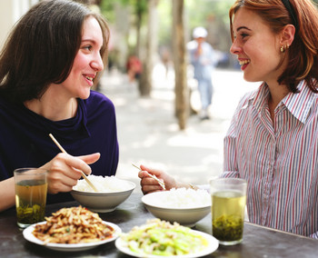
3-3 Let’s Practice
So you
drink coffee?
always
usually
often
sometimes
seldom
rarely
never
always
Yes.

Slide 7
3-3 Let’s Practice
I know. She
drinks coffee.
Mei doesn’t drink coffee.
never
always
usually
often
sometimes
seldom
rarely
never

Slide 8
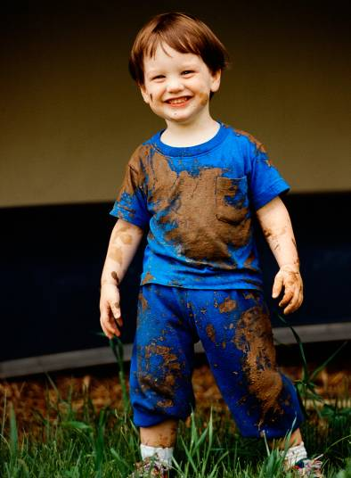
3-4 USING FREQUENCY ADVERBS WITH BE
Jeff is
always dirty.

Slide 9
3-4 USING FREQUENCY ADVERBS WITH BE
SUBJECT + BE + FREQUENCY
ADVERB
seldom
usually
never
often
rarely
dirty.
always
Jeff + is +
sometimes
am
is +
are
FREQUENCY ADVERB

Slide 10
3-4 USING FREQUENCY ADVERBS WITH BE
SUBJECT + FREQUENCY + OTHER SIMPLE
ADVERB PRESENT VERBS
+
seldom
Sergio
sometimes
usually
rarely
often
never
+ rides a bike.
always
all simple
present
verbs
except be
frequency adverb +

Slide 11
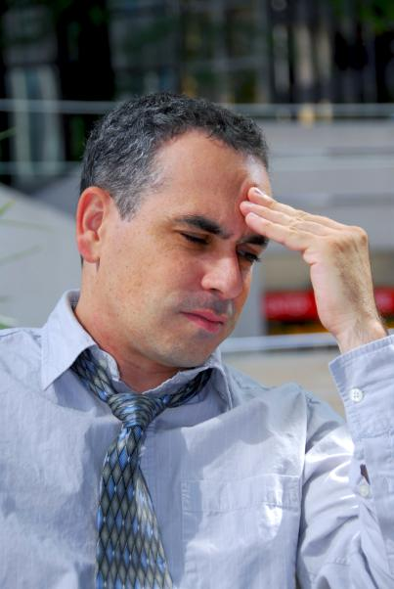
3-4 Let’s Practice
He is
tired.
usually
______________________________________

Slide 12
3-4 Let’s Practice
Jeff is
sad.
never
_________________________________________

Slide 13
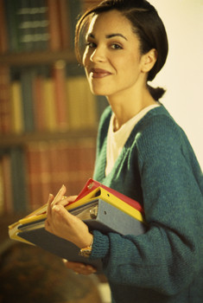
Lucy
3-4 Let’s Practice
reads at the library.
often

Slide 14
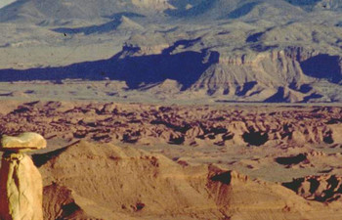
3-4 Let’s Practice
It
rains in the desert.
hardly ever

Slide 15
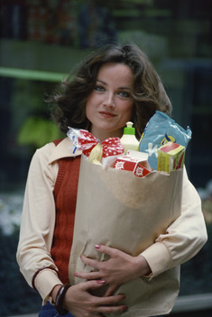
3-6 Let’s Practice
buy often
Gazi _________ too many things.
often buys

Slide 16
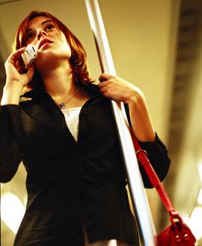
3-6 Let’s Practice
say always
always says
She __________ nice things.

Slide 17
3-6 Let’s Practice
worry often
Her father __________ about her.
often worries

